Slide 1
When We Say Value-Based Care or Value-Based Payment…… What is Value?
(September 21, 2019)
Timothy W. Attebery, DSc, MBA, FACHE
Chief Executive Officer
American College of Cardiology and MedAxiom

Slide 2
Disclosures
Nothing to disclose

Slide 3
Presentation Outline: 5 Parts
ACC Update
Background: U.S. Healthcare Problem
What is Value?
Avoidable Costs
Value-Based Reimbursement

Slide 5
The 2019-2023 Strategic Plan describes the College’s Destination.
HOW do we get there? Explore the Frontier, Protect the Core
Protect the Core
Explore the Frontier
As we Explore the Frontier to build new, innovative, and diverse means of serving members & customers, improving patient outcomes, and securing our financial future, we must Protect the Core of our enterprise—our brand, our relationships, plus a suite of successful, impactful, market-valued solutions/services built and maintained by a team nurtured by a culture of wellbeing.

Slide 6
“4 X 4 X 4” ACC Matrix for Strategic Execution
4 Strategic Goals
What We Must Accomplish by 2023
Urgency
Member of the Future
Agility
Health
System
Strategy
Innovation
Emerging Markets
Digital Transformation
Collaboration
4 Cultural Attributes
Organizational Personality
4 Strategic Imperatives
What We Must Get Right

Slide 7
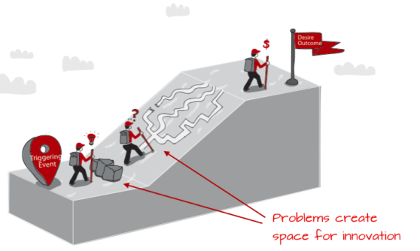
The Problem

Slide 8
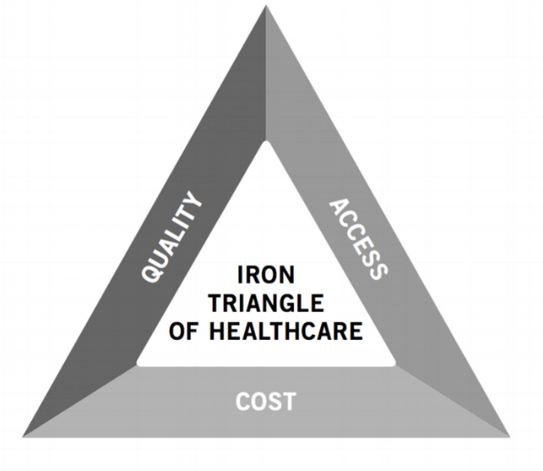
Iron Triangle: created by William Kissick, 1994.
Increasing or emphasizing one factor could create or cause a decrease in one or both of the remaining factors.
Example: efforts to cut costs could reduce quality and/or access
effectiveness
equity
efficiency

Slide 9
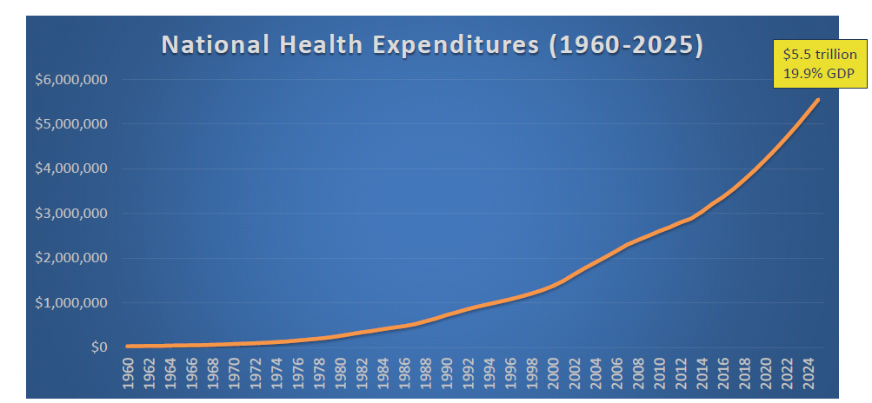
U.S. Health Care and the Federal Budget

Slide 10
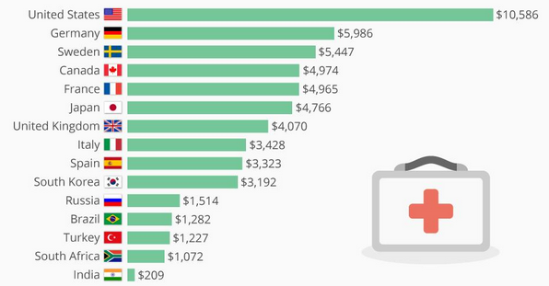
PER CAPITA HEALTHCARE SPENDING FOR 2018

Slide 11
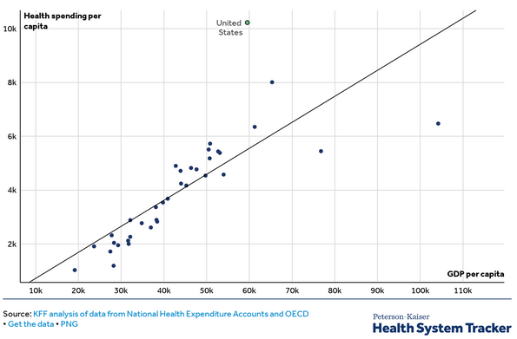

Slide 12
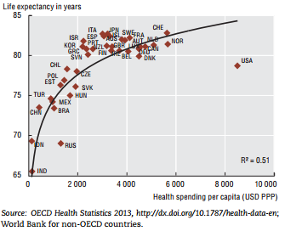

Slide 13
Why? Utilization? Price? Both?

Slide 14
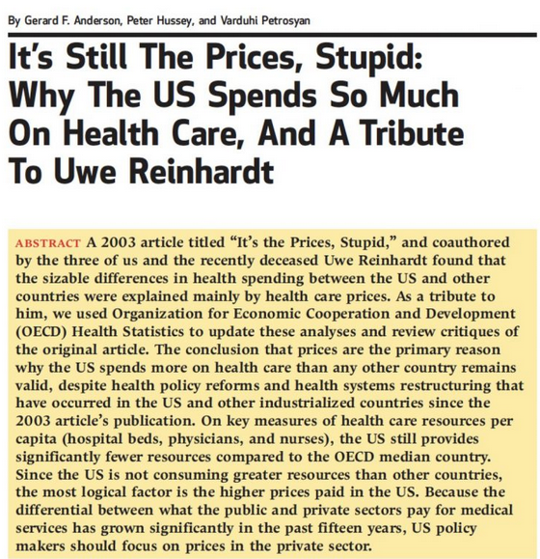
Why Overall Spending is Higher

Slide 15
State of CVD Services in the U.S.

Slide 16
Cardiology accounts for nearly 20% of spending throughout the entire health care system
Cardiology accounts for 30% of Medicare spending
Ojeifo O and Berkowitz SA Circ Qual Outcomes 2015

Slide 17
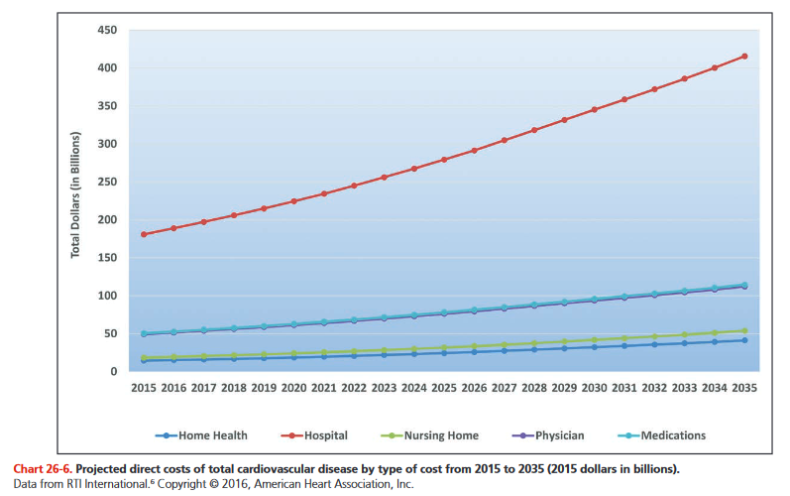
CVD Environment
120+ million Americans; #1 disease state and COD
#1 cost (20%+ of overall healthcare spending)
Top profit generator for most health systems
Largest payer (Medicare) is seven years away from insolvency
Significant disparities/inequities in care delivery; under-represented groups in CVD
$500B annual economic impact from CVD (direct and indirect costs to society); projected to exceed $1 trillion in 15-18 years
30% “avoidable” costs (waste, duplication, coordination, etc.)
Who will lead? How to remove some of the avoidable costs?
How to develop a more efficient system of CVD care?

Slide 18
Fragmentation Of Care
Primary
Care
Home
Health
Lack of Communication and Appropriate Follow-up
Specialty Care
Diagnostic Errors
In-patient &
Out-patient
Hospital
Hospice
Post-acute
Care
Hospital Readmission
Adverse Drug Events
Notes:
This graphic that conveys the fragmentation of cardiac care across the following settings:
Primary care
Specialty care
In-patient and out-patient hospital
Post-acute care (Skilled nursing facilities, rehab)
Home health
Hospice
and the results of that fragmentation:
adverse drug events
hospital readmissions
diagnostic errors
lack of appropriate follow-up testing

Slide 19
Michael Chernew, PhD – What will slow spending growth?
Payment reform
Benefit design (and other consumer oriented strategies)
Competition and managed care
Organization of medical practice
Wellness, prevention, nutrition, etc.

Slide 20
What is Value?

Slide 21
Value Definitions & Equations
“Price is what you pay, value is what you get.” –Warren Buffet
“Health outcomes achieved per dollar spent.” –Michael Porter, PhD

Slide 22
Two Value Perspectives
Value Generated (VG): the external value or overall outcome (utility) created for patients, purchasers/payers, and society by the services rendered or work performed. This can be stated in economic and non-economic terms. Sometimes referred to as “Consumer Welfare”.
Value Captured (VC): the internal value received, in the form of direct or indirect monetary compensation, for the VG generated.
Customers want VG>VC.
Service providers want VC>VG.
Currently, what do patients, purchasers/payers, and the public perceive about healthcare value?

Slide 23
Variables
VG = Value Generated (created for external stakeholders & society)
VC = Value Captured (captured for the organization & yourself)
Q = Quality (EBM, AUC, and clinical outcome)
S = Safety (avoidable complications, infections, falls, etc.)
PRO = Patient reported outcomes including perception of service delivery (HCAHPS)
A/E = Access & Equity
Ce = External Cost (a/k/a “price paid” or “P”) → Ce = P
Ci = Internal Cost (what it costs the HC organization to deliver a service)
O U T C O M E

Slide 24
VC = ƒ(VG)
In general, VC is a derivative of VG (to increase VC, you need to increase VG)
An individual’s economic VC (their compensation) is a function of their VG and their personal efforts to help their organization increase VC
An organization’s VC (reimbursement, total revenue) is primarily a function of VG by that organization

Slide 25
For Healthcare Providers
VG is recognized in accounting terms as Revenue (for NFPs, add Community Benefit)
Gross Revenue = the total value of services rendered using the gross charge for each service
Net Revenue = the expected payments from the Gross Revenue

Slide 26
Healthcare Value Equation
VG = O/P
Value Generated (for society) = Outcomes divided by the Payment for the service rendered

Slide 27
What About the Time Element?
Is VG measured only at one point in time?
Increasingly, healthcare providers are being evaluated by their ability to manage a patient or condition over time (30 day readmission, 90-day bundle)
OUTCOME involves a time window

Slide 28
Think of P in Broader Terms
P for a certain episode (e.g., one admission or procedure): DRG, CPT, APC, etc.
P for the “total expenditures incurred” in connection with one episode (e.g., 90-day period following a CABG or PCI)
P for the “total cost of managing a certain population of patients”

Slide 29
But Wait, What About Risks
Taking risk (indemnification) is a value generator
Economic utility of managing and reducing uncertainty (probability of having a loss)
“Risk Premium” – amount above the “expected loss” that someone is willing to pay to have insurance
Who takes the risk for the efficiency of CV care with a health system?
Who takes the risk for the total cost of CV care in the U.S.?
What’s the economic value of taking risks?

Slide 30
The Value of Taking Risk
Offloading risk requires $$
“I don’t want to assume the risk that the CVSL will achieve a certain operating margin this year”
“I don’t want to assume the risk that the total cost of an episode of CV care will be less than the bundled payment”
When you don’t take economic risk, then you’re “paying” someone else to do so
Fear of loss is a greater motivator than the hope for gain

Slide 31
Value Generated with Risk
VG = (O/P) * R
R = Risk Assumed, a Risk Premium $ is paid in exchange for taking the risk

Slide 32
VC Equation (pure FFS)
SR = Service Rendered
GR = SR X Gross Charge for that service
NR = GR X CR (Collection Rate)
Profit = NR – OE (Operating Expenses)
OE = ƒ((SR) X EF (Efficiency Factor))
Personal Comp (personal VC) = ƒ(wRVUs) (prevailing measure)
Since the per wRVU Conversation Factor is not adjusted based upon NR/CR/OE/Profit, there is no Risk Premium value included

Slide 33
Personal Compensation
Production-based: wRVUs X Conversion Factor
Performance-based: some % of comp pool withheld or set-aside to be “earned” by performance (quality/safety, projects, efficiency, etc.)
Who is paying the compensation?
They assume the risk for billing & collection, capital expenditures, managed care contracting, management, operating expenses, etc.

Slide 34
VC Equation (Risk-Based)
SR = Service Rendered (in connection with the episode)
NR = Fixed Payment for the Episode (Risk Premium loaded within the NR)
Profit = NR – OE (all costs incurred associated with the episode and time window)
OE = ƒ((SR) X EF (Efficiency Factor))
Personal VC = ƒ(Excess Revenue over OE)

Slide 35
Efficiency Factor
Input pricing
Resources consumed
Variable expenses/resources (consumption/utilization)
Fixed expenses/resources
Throughput (productivity)
Rework
Amount of “waste” in the system
Avoidable variation (standardization)

Slide 36
Basic Ways to Increase VG
DECREASE UTILIZATION: (decrease overall payments)
DECREASE P (Ce): charge or accept a lower price
(NOTE: requires a reduction in Ci; otherwise margins decline)
IMPROVE OUTCOMES (quality, safety, patient reported outcomes, access, equity)
TAKE MORE RISKS

Slide 37
Increase Internal VC
Decrease Ci (decrease OE; variable costs, fixed costs, indirect costs, etc.); this involves efforts to increase efficiency (workflows, process improvement, etc.)
Increase SR (more productivity, better coding & documentation)
Optimize capacity (division of labor, new workflows, move lower margin or negative margin episodes/services out of the hospital or ambulatory facility and replace with higher margin services)
Increase NR and CR (documentation, coding, and optimize capacity)
Lead and support efforts to improve OUTCOMES
Take accountability and share the risk
Any combination of these options

Slide 38
Avoidable Costs: Waste and Inefficiencies in Healthcare

Slide 39
Avoidable Costs (“waste”)
New England Health Institute (NEHI): “healthcare spending that can be eliminated without reducing quality of care.”
Misuse, overuse, underuse
Unwarranted or unexplained variation in care
Fraud and abuse

Slide 40
It’s the Cost, Stupid – Avoidable NHE
NEHI (2008) → $680B
Thomson Reuters (2009) → $700B
Berwick & Hackbarth (2011) → $500B-$1T
Avoidable inpatient admissions → $140B
Center for Health Info. & Analysis → $17Bª
IMS Institute (2013) → $213B^{b}
(a) Limited to avoidable readmissions
(b) Limited to prescription drugs; hypercholesterolemia & diabetes have the biggest impact

Slide 41
Eight Categories of Waste & Avoidable Costs
Administrative system inefficiencies
Provider inefficiencies and errors (including unnecessary variations in care delivery)
Lack of care coordination
Unwarranted use
Preventable conditions and avoidable care
Fraud & abuse
Increased disease due to modifiable behaviors
High prices

Slide 42
Value-Based Care & Value-Based Payment
a/k/a risk-based reimbursement, outcomes-based reimbursement, pay-for-value, pay-for-performance, fee-for-value

Slide 43
Definitions
A care delivery model in which clinicians and hospitals are paid based upon outcomes.
Rewards clinicians for helping patients improve their health, reduce the effects and incidence of chronic disease, and live healthier lives.
Rewards clinicians for reducing costs (i.e., increase efficiency, remove the avoidable costs).
Linking payments to improved performance; holding providers accountable for both the cost and outcomes of the care provided.
New England Journal of Medicine Health Catalyst, January, 2017;
Healthcare.gov definition of value-based purchasing

Slide 44
U.S. Value-based Payment Model Framework
Category 1 Fee for Service – No Link to Quality & Value | Category 2 Fee for Service – Link to Quality & Value | Category 3 Alternative Payment Models Built on Fee-for-Service Architecture | Category 4 Population-Based Payment
 | A Foundational Payments for Infrastructure & Operations B Pay for Reporting C Rewards for Performance D Rewards and Penalties for Performance | A Alternative Payment Models with Upside Only Gainsharing B Alternative Payment Models with Upside Gainsharing and Downside Risk | A Condition-Specific Population-Based Payment B Comprehensive Population-Based Payment

Slide 45
Hospital Bundles/Episodes of Care
Episodes:
Acute myocardial infarction
Congestive heart failure
Cardiac arrhythmia
Cardiac defibrillator
Cardiac valve
Pacemaker
Percutaneous coronary intervention
Coronary artery bypass graft surgery
Transcatheter Aortic Valve Replacement (TAVR)
90-day episodes
Total cost of care
Risk-adjusted target price
Quality performance measures
Shared savings with clinicians

Slide 46
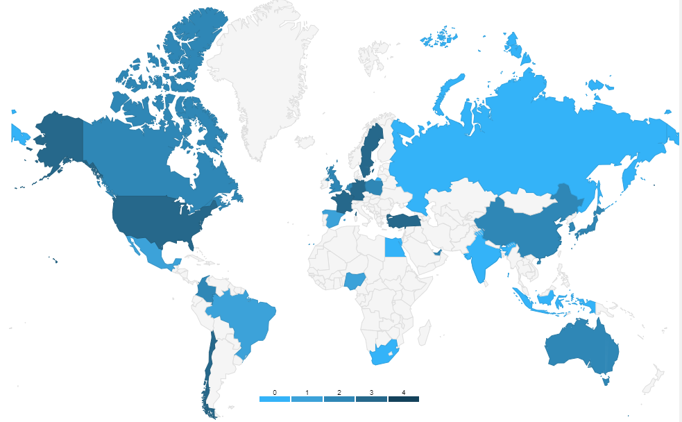
Global Progress to Outcome-based Payment
Although payment systems differ, the pressure to lower costs and improve outcomes is universal.
0 = No efforts toward bundled payments (mainly FFS)
1= Capitation system is used by one or more major payers
2 = National/regional initiative to develop bundled payment system
3 = Bundled payment system implemented by one or more major payers
Value-based Healthcare: A Global Assessment, Commissioned by Medtronic. The Economist, 2016. http://vbhcglobalassessment.eiu.com/

Slide 47
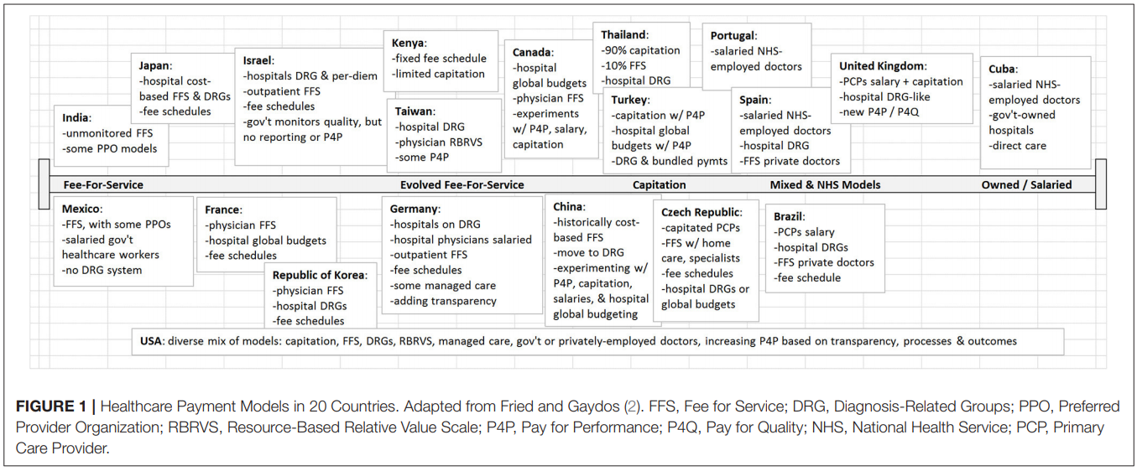
The International Move to Value
Counte MA, Howard SW, Chang L, Aaronson W. Global Advances in Value-Based Payment and Their Implications for Global Health Management Education, Development, and Practice. Front Public Health. 2019;6:379. Published 2019 Jan 18. doi:10.3389/fpubh.2018.00379

Slide 48
Physician Roles
Primary: (a) clinician and clinical manager (quality/safety, risk manager, care coordination), and (b) resource/cost manager (money manager)
Secondary: (a) patient experience manager (relationship, quality of life, intangibles), and (b) information/data manager
Tertiary: (a) team leader (getting the most from the other team members), (b) quality improvement and operations manager (performance & process improvement), and (c) organizational leader and change agent
Value generator: for patients, for the organization, for society
Value capturer: individually and for the organization

Slide 49
THANKS!

